Slide 1


Bank Loan Case Study and Report
PRESENTED BY:
Shaik Mabu Basha

Slide 2
PROJECT DESCRIPTION
In this project we are going to identify patterns which indicate if a client has difficulty in paying their installments which may be used for taking actions such as denying the loan , reducing the amount of loan ,lending (to risky applicants) at higher rate of interest.
This will ensure that the customers capable of repaying the loan are not rejected.
We are going to analyze the data by EDA(Exploratory Data Analysis) which is used to summarize ,visualize and understand the characteristics of the given dataset.
The main aim of EDA is to discover the patterns and relationships that can be used for the decision-making and analysis

Slide 3
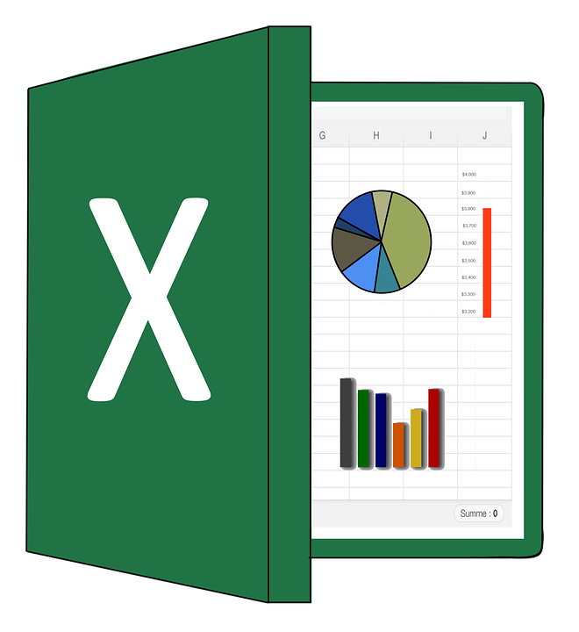


Tech-Stack Used
I have used Microsoft Excel to do the analysis and Jupyter for cleaning the Previous Application as it is having large number of rows.
I used Microsoft presentation to make ppt for the project

Slide 4

1 .Application data
Approach:
Approach towards the project means Overall strategy that outlines how the project will be executed or done to achieve its Objectives.In this project first we need to import the dataset that provided and load that into Excel. After loading the data use specific functions and formulae in excel in order to achieve the required tasks in the project. If needed use charts to visualise the data in effective way

Slide 5

Cleaning the data
Cleaning the data is an crucial step in any data analysis as it ensures the data is accurate, reliable and consistent .
Without data cleaning ,Our data analysis will be inaccurate ,incomplete and inconsistent which can lead to serious consequences in decision making.
There are some steps involved in Cleaning the data .Those are discussed below in detail
STEP 1 : Removing duplicates
First we need to check if there are any duplicates present in the primary key of the given data set. Here I took SK_ID_CURR as primary key because it’s the unique value of the given data set.I removed duplicate by using “Remove Duplicates ” feature in Excel by selecting category as SK_ID_CURR
.

Slide 6
STEP 2: Finding Missing Values
Missing values are those which are not available in our dataset due to various reasons such as human errors or system issues.We should handle those values. First I found the count of null or missing values in each column using COUNTBLANK function in Excel and also calculated percentage of null values in each column.
STEP 3: Handling Missing Values
After finding the percentage of Missing values in each column and I deleted the columns which are having blanks percentage more than 50 %. Because the analysis wouldn’t be fair if we are having majority values in columns are missing. So I used this Criteria to delete columns.
STEP 4:Removing Irrelevant Columns
There are many unnecessary columns present in our dataset .It is better to delete those columns as it helps to reduce the size of dataset ,improve efficiency of our analysis and eliminate irrelevant information.In the given data set columns giving normalised information about building where the client lives,apartment size ,living area, common area, number of elevators , number of entrances, number of floors etc..I deleted these columns and also majority of these columns having missing values.

Slide 7
STEP 5: Imputing with Mean/Median
We can replace the values in columns with less than 50 % with Mean or Median depending upon the category of the column.
Here , For continuous variable columns such as Amount_Annuity , Ext_Source_3 , I found mean of that columns in the Excel using “MEAN” function and then replaced null values using “Find and Replace” option by keeping null in “Find” and mean in “Replace”
For categorical columns such as AMT_REQ_CREDIT_BUREAU(Number of Enquiries), I found most repeated category by using “MODE” function in Excel.Then I replaced all missing values with Mode of that column

Slide 8
IDENTIFYING OUTLIERS
We know that the Outliers are the data points that lie far away from the rest of the data points due to some measurement errors , data entry errors and some other natural errors.
These can affect the statistical analysis of the data as they reduce accuracy of models.I found those outliers using Box and Whisker plot .
We can also find outliers using Tukey’s method.
Steps to find Outliers using Tukey’s method:
1.Finding 1st Quartile Q1 and 3rd Quartile Q3
2.Finding Inner Quarter Range(IQR)
3.Finding Upper Bound(Q3+(1.5*IQR)
4.Finding Lower Bound(Q1-(1.5*IQR)
5.Now, any data point above Upper Bound or Below Lower Bound Considered as Outlier
Below , I plotted some Box-Whisker Plots to find there are any outliers present in the data.

Slide 9
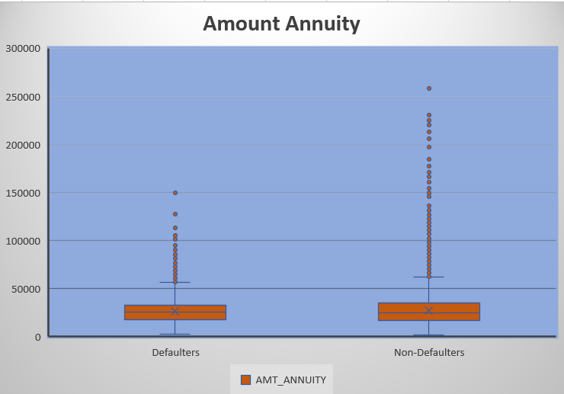
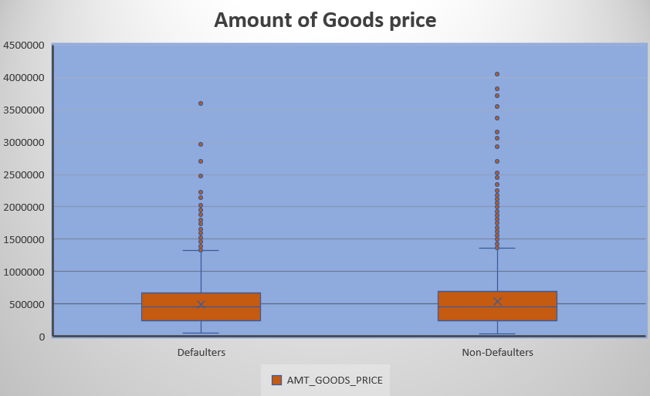
In Box-Whisker plot,Box represents the middle 50% of the data i.e InnerQuarter Range ,while the whisker represents range of data outside of the box.Outliers are the data points that lie outside the whiskers
We can see that there are outliers in “Amount Annuity” and “Amount of Goods Price” as there are many data points lying outside the Whiskers
Non-Defaulters category having more number of Outliers when compared to Defaulters

Slide 10
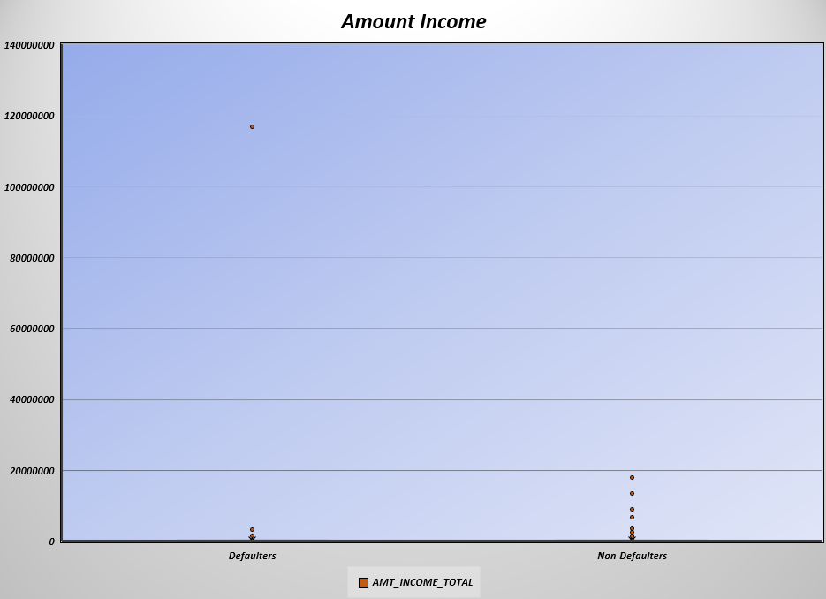
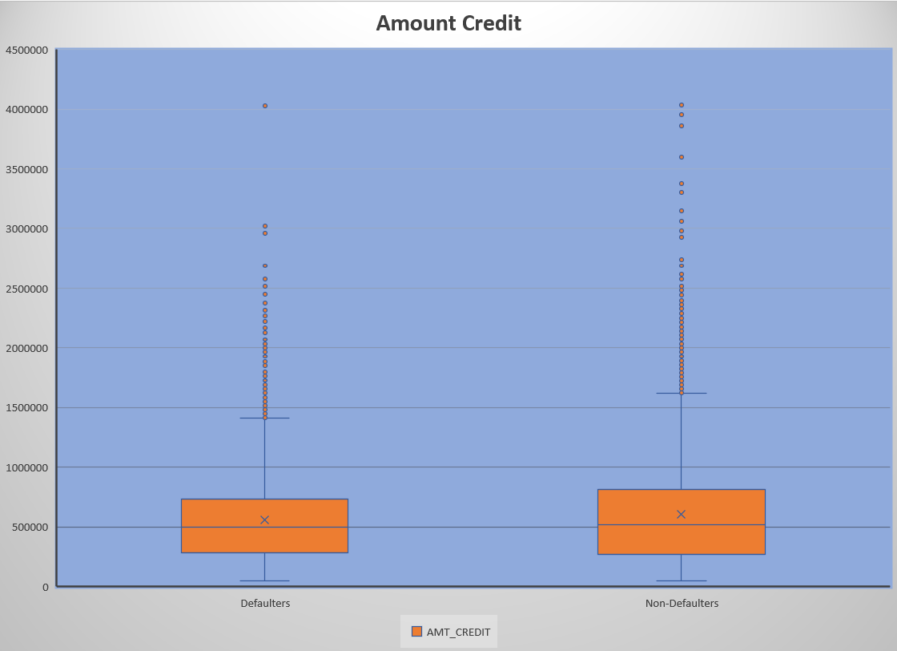
In “Amount Income” column ,there are Outliers present in both Defaulters and Non-Defaulters column.We can clearly see that the data point touches 120 million mark.These values can affect the statistical analysis of the data
In “Amount Credit” Column ,we can observe that both Defaulters and Non-Defaulters ,Large number of Outliers present in the data.In EDA [Exploratory Data Analysis], It’s not necessary to remove data points.

Slide 11
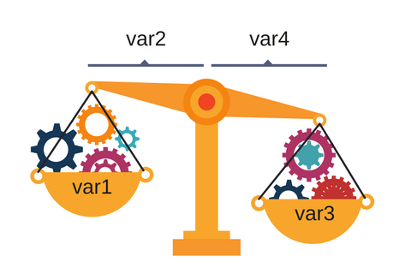
DATA IMBALANCE
Data Imbalance refers to situation where the classes in classification problem are not equally represented in the dataset.
Imbalanced datasets can lead to poor performance in data analysis because data model may be biased towards majority of classes and have difficulty in identifying minority classes.
We can find the data imbalances by creating the pivot chart of Histogram in excel.
First we need to insert cleaned data into Pivot Table and then select the column you need to find if there is any data balance in “rows” field and again inti “columns” field by changing summarize value by “Count”
Then we can change “show value as” into “%of grand total” and create a pivot chart by selecting Histogram or any other charts to visualise data imbalnce

Slide 12
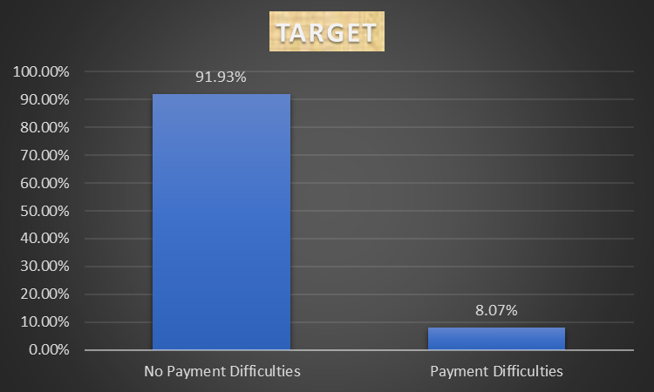
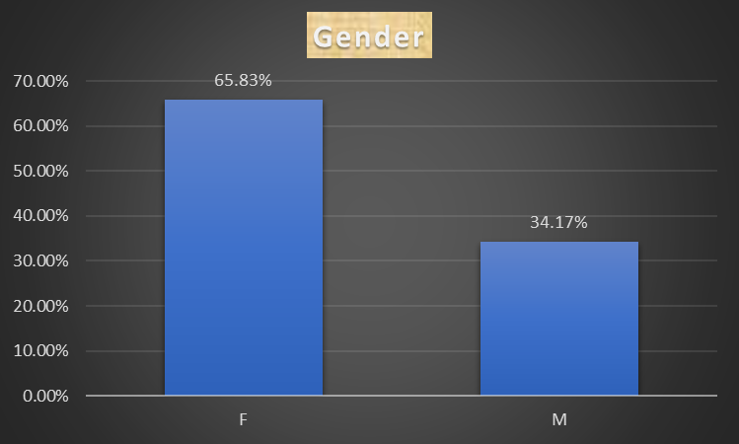
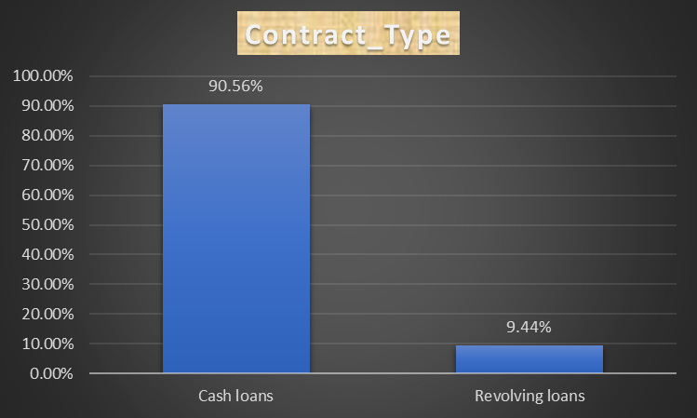
In Target variable,Clients with No Payment Difficulties are 91% where as Clients with Payment Difficulties are only 9%.Clearly there is imbalance in data.In Gender Category Males(34%) are nearly half of the percentage of Females(66%).
In Contract_Type , Cash loans are nearly 91 % where as Revolving loans are just 9 %

Slide 13
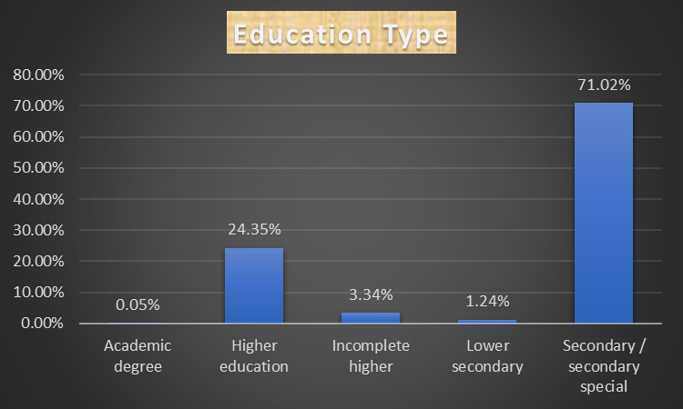
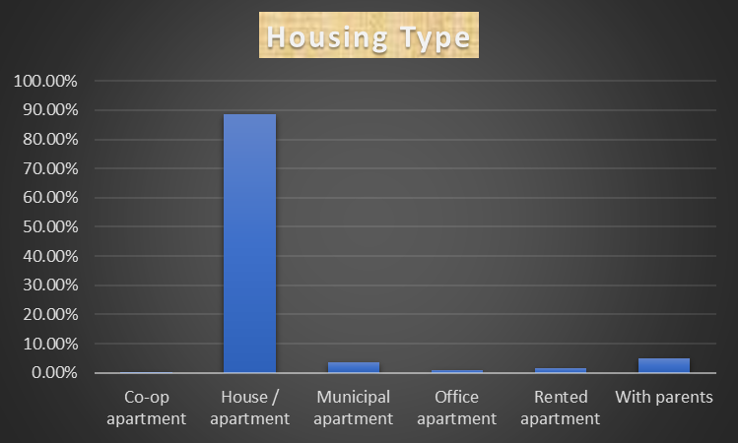
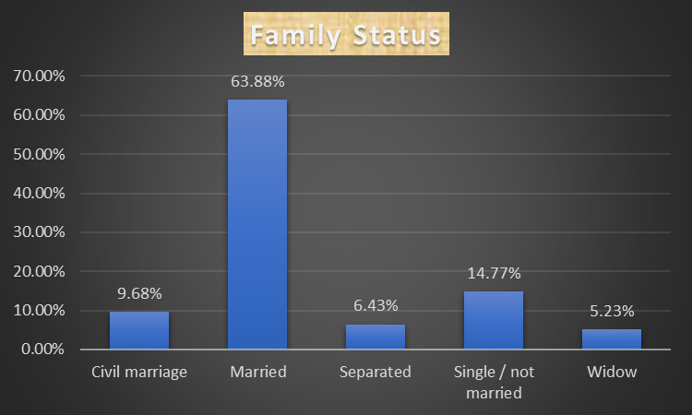
Many of the Clients Education is Secondary/Secondary Special (71%)and there are least clients (.05%) having academic Degree
Many of the Clients Family status is Married(64%) and Most of the clients (Housing type) live in House/Apartment(90%)

Slide 14

UNIVARIATE ANALYSIS ON CAREGORICAL VARIABLES
Univariate analysis is statistical method to analyze the data with one variable.
It involves the examining the distribution of single variable and deriving insights from it.
Univariate analysis of categorical variables involves summarizing and examining the frequency or proportion of each category to gain better understanding of distribution and relationship between variables

Slide 15
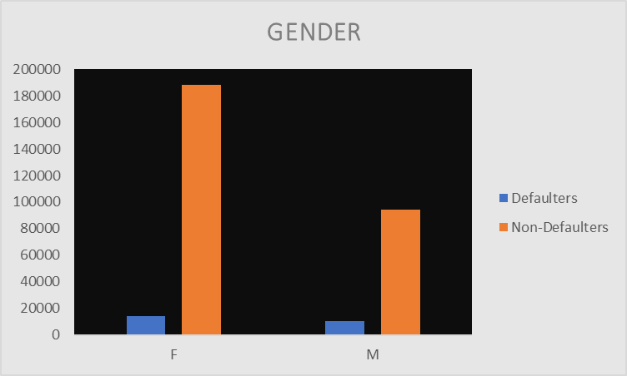
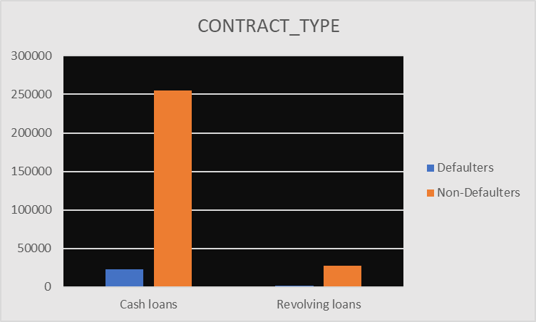
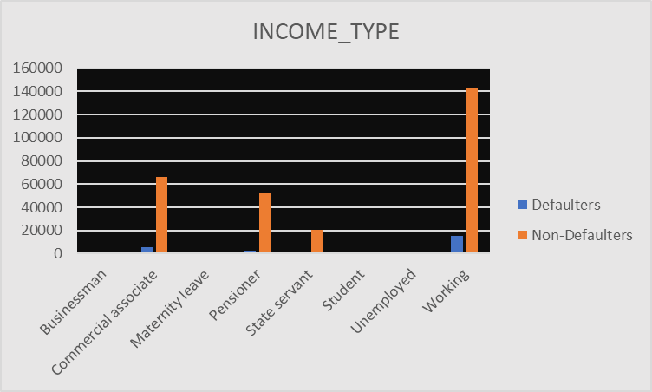
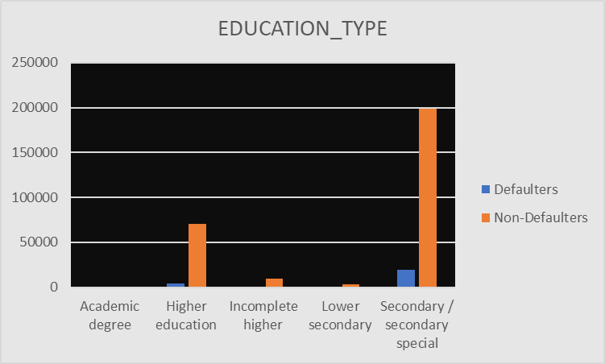

Slide 16
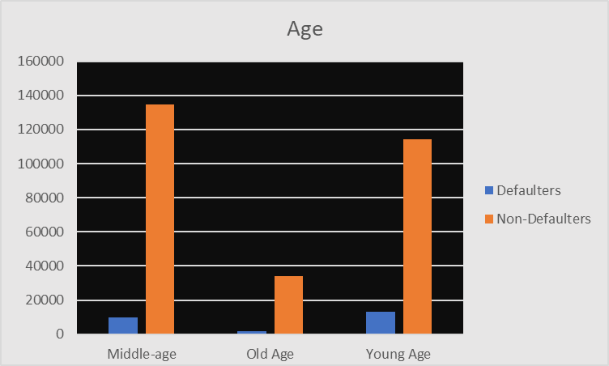
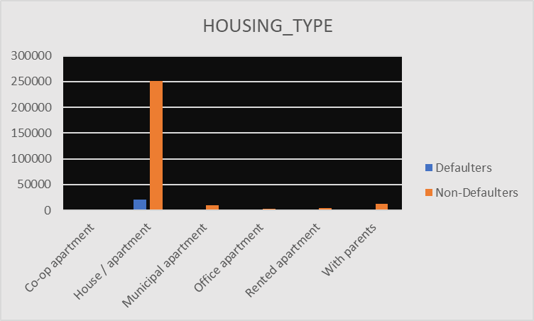
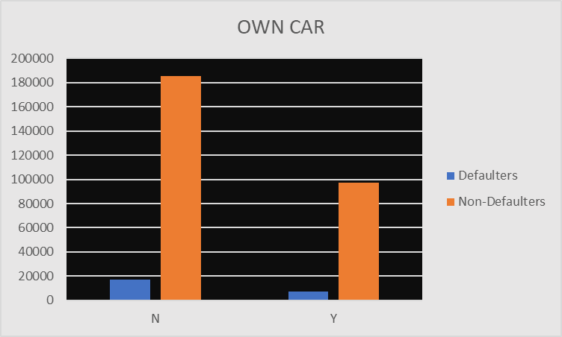

Slide 17
Insights from the Graphs for univariate analysis
Gender : We can infer that many of the Clients are Females when compared to males.Females clients having more payment difficulties when compared to Male Clients
Contract_Type : Clients prefer Cash loans when compared to Revolving loans and also Client gets Payment difficulties in it .
Income_Type : Income of the many clients who took loans are from Working profession and unemployed ,student took least number of loans
Education_Type: Clients who done Secondary Education took maximum number of loans and some of them having payment difficulties
Age_Bin : Middle Aged and Young Age people took high number of loans Meanwhile Old age people have taken less number of loans.Young Age people having more Payment Difficulties when compared to others
Housing_Type: Many of the Clients are living in House/Apartment .Clients who are having rented apartments finding difficulty in paying loans.
Own_Car: We can observe that there is not much variation in Clients having car or not. Both data distribution is much similar

Slide 18
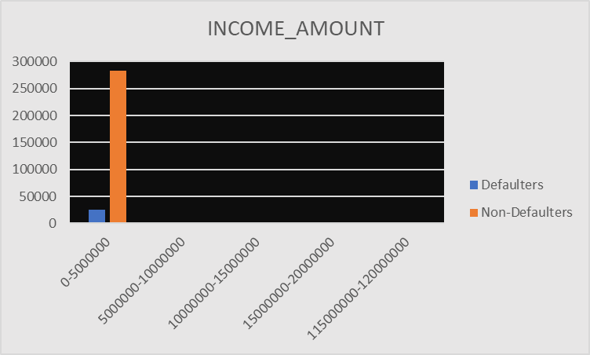
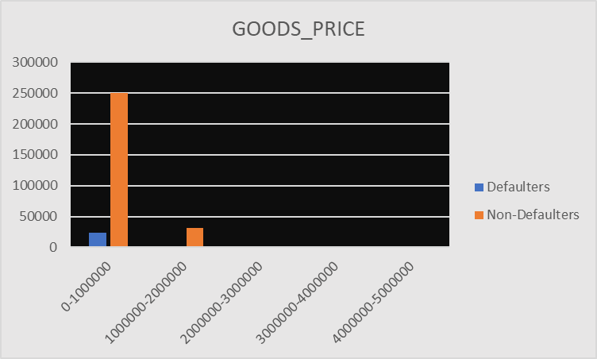
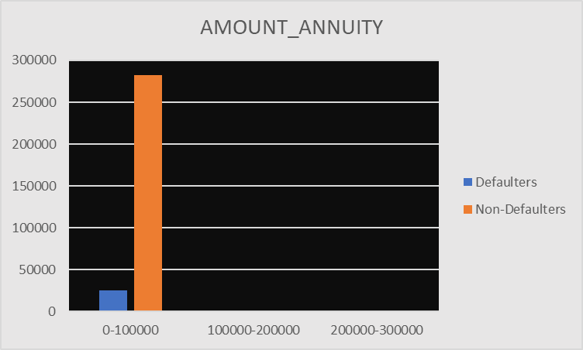
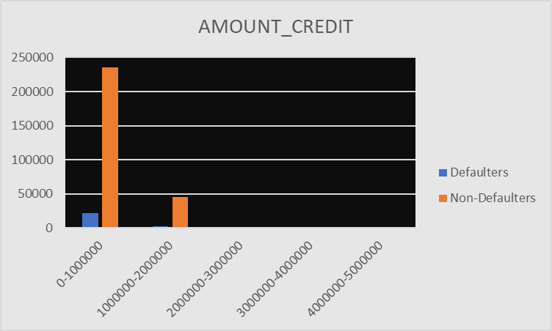
Univariate analysis on Continuous Variables

Slide 19
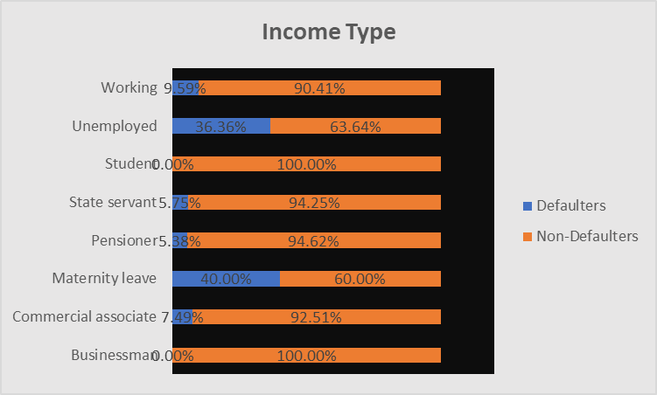
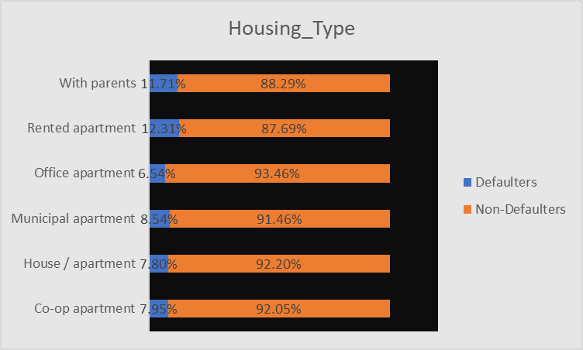
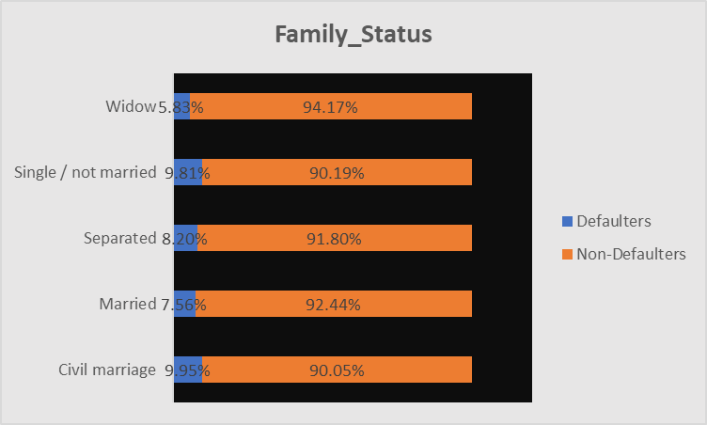
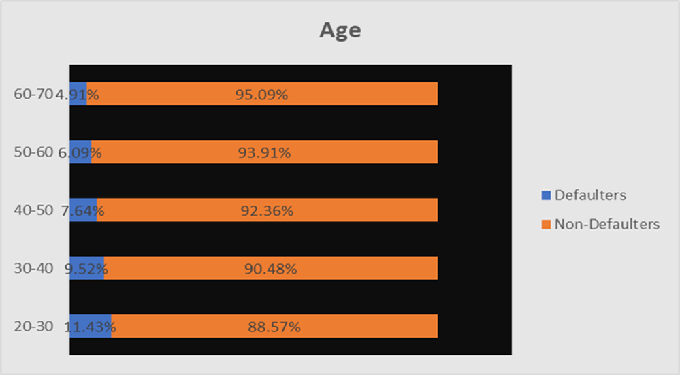
Univariate Segmented Analysis

Slide 20
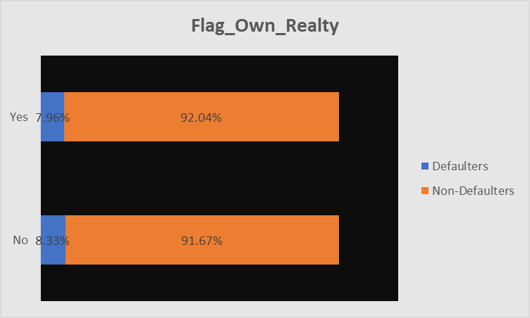
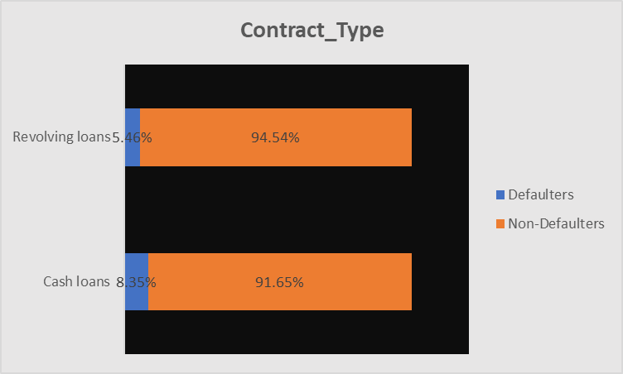
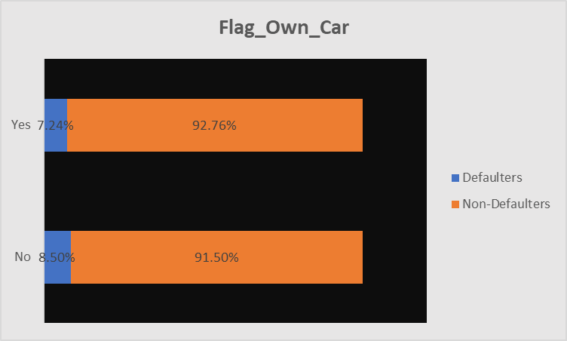

Slide 21
Insights from above Charts
Income Type : We can see that Students and Business man capable of Paying back the loans without any due.While those are Maternity leave are facing difficulties in paying back their loans(42%)
Housing Type : Clients living with parents about 11% having difficulty in paying loans and those are living in apartments with least about 6 %
Family_Status : About 10 % of Single/Not Married Clients facing difficulties in paying back loans and Widows face least difficulty in paying the loan (5%)
Age : Most of the Clients, About 12 %,whose age in between 20-30 are considered as defaulters as they don’t pay loan in time.While majority of older people paid loan in time.
Own Realty : There is no significance difference in Clients which own property or not
Contract_Type : Clients,about(9%) who took cash loans, having difficulties in paying loans when compared to Clients who took Revolving Loans

Slide 22
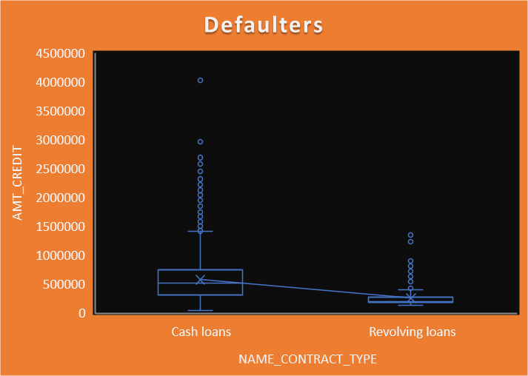
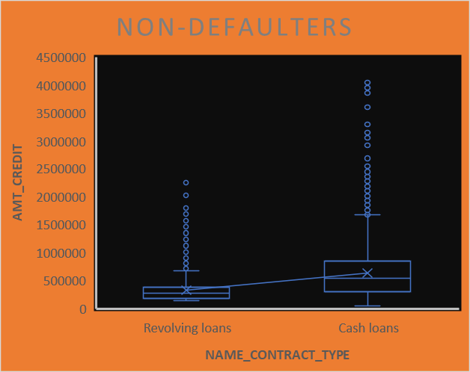
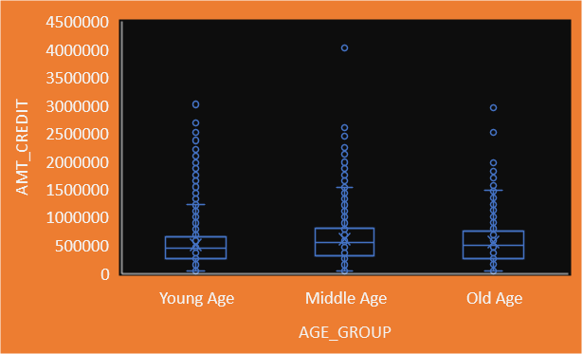
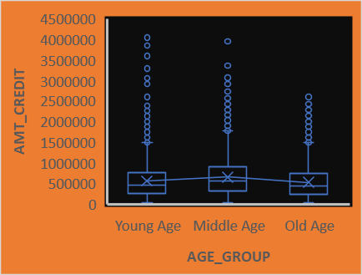
Bi-Variate Analysis on Category variables

Slide 23
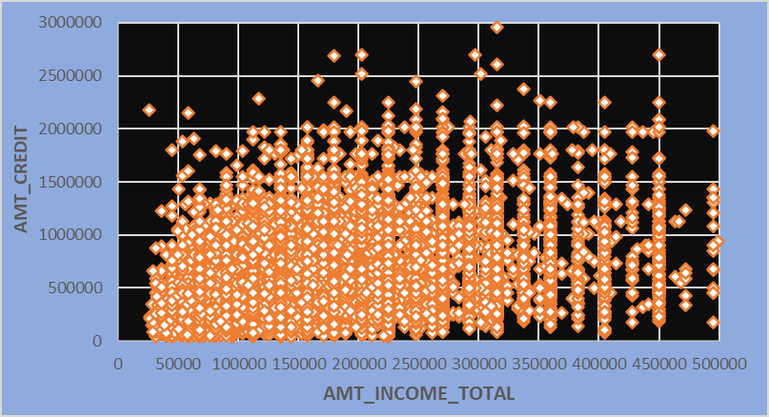
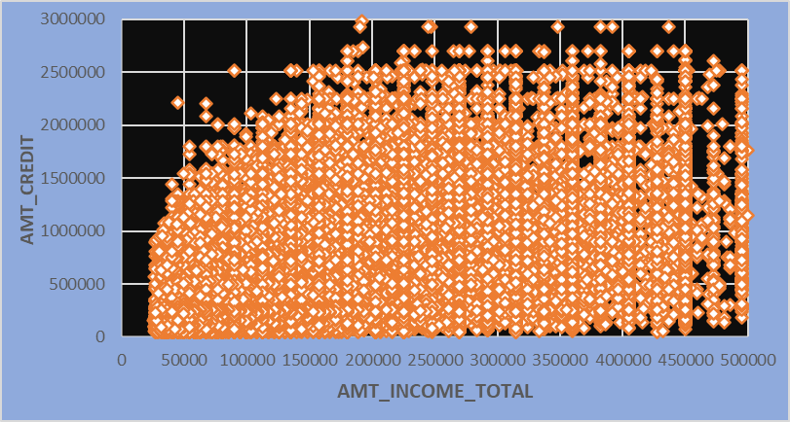
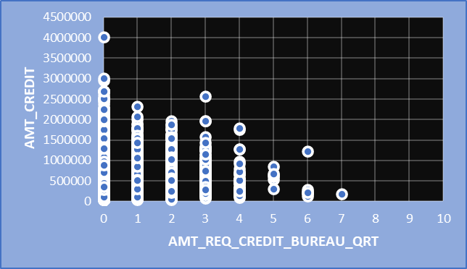
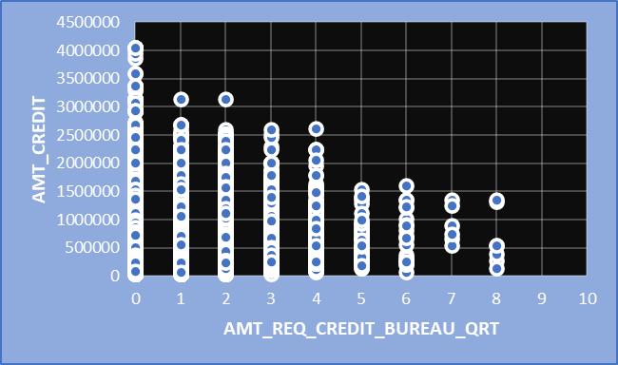
Bivariate analysis on continuous variables

Slide 24
Insights from Bivariate analysis
Amount Credit and Contract Type : We can find more outliers in Credit amount for the Cash loans when compared to the Revolving loans.Both Defaulters and Non-Defaulters follows same pattern.The Box and Whisker plot shows the relation between them.
Amount Credit and Age Group: Both Defaulters and Non-Defaulters have credit below 4.5 Million.We can see there are more outliers as the credit amount increase especially in younger and Middle Aged people
Amount Credit and Amount Income : As the Income increases Credit also increases much in Non-Defaulters when compared to Defaulters. We can observe this from the Scatter Plot. Defaulters having more Outliers when compared to others.
Amount credit and credit Number of enquiries in Quarter :We are having less number of enquiries if the credit amount is more.This pattern is strong in Defaulters case when compared to Non-Defaulters .

Slide 25
Correlation Analysis
Correlation analysis is Statistical method used to measure strength and direction of the relationship between two variables.
Correlation Coefficient is the measure of linear relationship between two variables.The value of correlation coefficient ranges from -1 to +1
Positive value indicates positive relationship and Negative Value indicates negative relationship.Zero value indicates there is no relationship between those variables
To get correlation matrix ,First we need to select the variables data of which we want to get the correlation matrix then go to “Data analysis” feature in Excel and then Select “Correlation” to get Correlation Matrix
The cell value In the Correlation matrix is Correlation coefficient between corresponding row variable and column variable.
The Diagonal values always equal to 1 in Correlation Matrix as they represent correlation of a variable itself.

Slide 26
Correlation Matrix for Non-Defaulters
 | CNT_CHILDREN | AMT_INCOME_TOTAL | AMT_CREDIT | AMT_ANNUITY | AMT_GOODS_PRICE | REGION_POPULATION_RELATIVE | Age | Years Employed | CNT_FAM_MEMBERS | REGION_RATING_CLIENT | EXT_SOURCE_2 | EXT_SOURCE_3
CNT_CHILDREN | 1 | 0.028 | 0.003 | 0.021 | -0.001 | -0.024 | -0.337 | -0.041 | 0.879 | 0.023 | -0.015 | -0.037
AMT_INCOME_TOTAL | 0.028 | 1 | 0.343 | 0.419 | 0.349 | 0.168 | -0.063 | 0.035 | 0.034 | -0.187 | 0.140 | -0.059
AMT_CREDIT | 0.003 | 0.343 | 1 | 0.771 | 0.987 | 0.100 | 0.047 | 0.084 | 0.065 | -0.103 | 0.129 | 0.033
AMT_ANNUITY | 0.021 | 0.419 | 0.771 | 1 | 0.777 | 0.121 | -0.013 | 0.053 | 0.076 | -0.132 | 0.127 | 0.025
AMT_GOODS_PRICE | -0.001 | 0.349 | 0.987 | 0.777 | 1 | 0.104 | 0.045 | 0.085 | 0.063 | -0.104 | 0.136 | 0.036
REGION_POPULATION_RELATIVE | -0.024 | 0.168 | 0.100 | 0.121 | 0.104 | 1 | 0.025 | -0.009 | -0.023 | -0.539 | 0.198 | -0.011
Age | -0.337 | -0.063 | 0.047 | -0.013 | 0.045 | 0.025 | 1 | 0.226 | -0.286 | -0.002 | 0.078 | 0.175
Years Employed | -0.041 | 0.035 | 0.084 | 0.053 | 0.085 | -0.009 | 0.226 | 1 | -0.010 | 0.016 | 0.074 | 0.097
CNT_FAM_MEMBERS | 0.879 | 0.034 | 0.065 | 0.076 | 0.063 | -0.023 | -0.286 | -0.010 | 1 | 0.028 | -0.001 | -0.023
REGION_RATING_CLIENT | 0.023 | -0.187 | -0.103 | -0.132 | -0.104 | -0.539 | -0.002 | 0.016 | 0.028 | 1 | -0.291 | -0.004
EXT_SOURCE_2 | -0.015 | 0.140 | 0.129 | 0.127 | 0.136 | 0.198 | 0.078 | 0.074 | -0.001 | -0.291 | 1 | 0.076
EXT_SOURCE_3 | -0.037 | -0.059 | 0.033 | 0.025 | 0.036 | -0.011 | 0.175 | 0.097 | -0.023 | -0.004 | 0.076 | 1

Slide 27
Correlation matrix for defaulters
 | CNT_CHILDREN | AMT_INCOME_TOTAL | AMT_CREDIT | AMT_ANNUITY | AMT_GOODS_PRICE | REGION_POPULATION_RELATIVE | Age | Years Employed | CNT_FAM_MEMBERS | REGION_RATING_CLIENT | EXT_SOURCE_2 | EXT_SOURCE_3
CNT_CHILDREN | 1 | 0.005 | -0.002 | 0.031 | -0.008 | -0.032 | -0.259 | -0.044 | 0.886 | 0.041 | -0.012 | -0.024
AMT_INCOME_TOTAL | 0.005 | 1 | 0.038 | 0.046 | 0.038 | 0.009 | -0.003 | -0.001 | 0.007 | -0.021 | 0.007 | -0.018
AMT_CREDIT | -0.002 | 0.0381 | 1 | 0.752 | 0.983 | 0.069 | 0.135 | 0.098 | 0.051 | -0.059 | 0.121 | 0.052
AMT_ANNUITY | 0.031 | 0.0464 | 0.752 | 1 | 0.753 | 0.072 | 0.014 | 0.041 | 0.076 | -0.074 | 0.116 | 0.032
AMT_GOODS_PRICE | -0.008 | 0.0376 | 0.983 | 0.753 | 1 | 0.076 | 0.136 | 0.104 | 0.047 | -0.066 | 0.131 | 0.053
REGION_POPULATION_RELATIVE | -0.032 | 0.0091 | 0.069 | 0.072 | 0.076 | 1 | 0.048 | 0.016 | -0.030 | -0.443 | 0.170 | -0.010
Age | -0.259 | -0.0031 | 0.135 | 0.014 | 0.136 | 0.048 | 1 | 0.281 | -0.203 | -0.034 | 0.108 | 0.134
Years Employed | -0.044 | -0.0010 | 0.098 | 0.041 | 0.104 | 0.016 | 0.281 | 1 | -0.010 | -0.005 | 0.089 | 0.056
CNT_FAM_MEMBERS | 0.886 | 0.0067 | 0.051 | 0.076 | 0.047 | -0.030 | -0.203 | -0.010 | 1 | 0.044 | 0.002 | -0.029
REGION_RATING_CLIENT | 0.041 | -0.0215 | -0.059 | -0.074 | -0.066 | -0.443 | -0.034 | -0.005 | 0.044 | 1 | -0.250 | 0.014
EXT_SOURCE_2 | -0.012 | 0.0071 | 0.121 | 0.116 | 0.131 | 0.170 | 0.108 | 0.089 | 0.002 | -0.250 | 1 | 0.049
EXT_SOURCE_3 | -0.024 | -0.0182 | 0.052 | 0.032 | 0.053 | -0.010 | 0.134 | 0.056 | -0.029 | 0.014 | 0.049 | 1

Slide 28
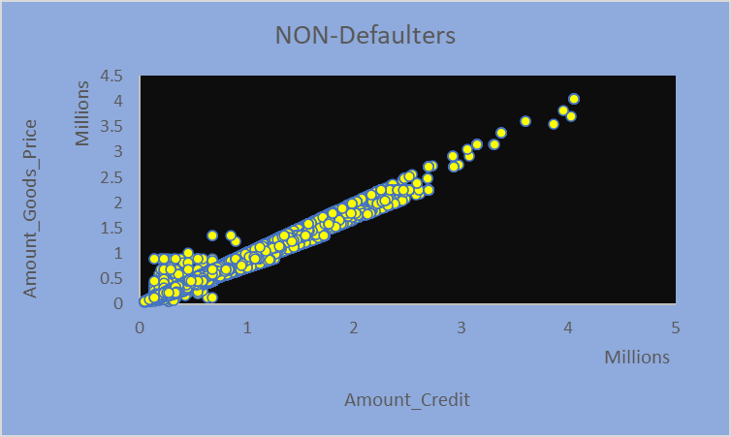
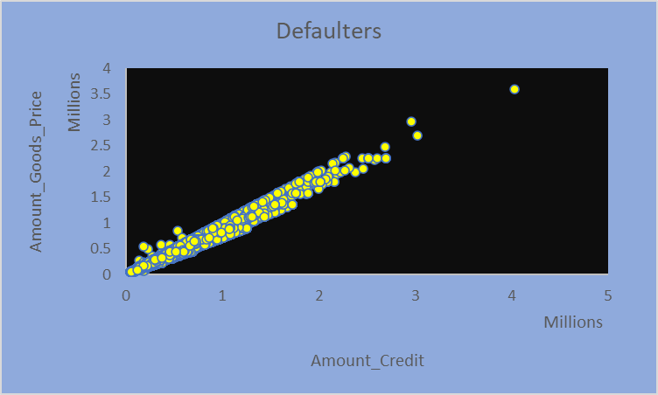
Amount Credit and Amount Goods Price: The Correlation coefficient between these two variables is 0.9 which is very close to 1.
I have plotted Scatter Plot to show Visually. If the amount of credit increases then Amount of goods price also increases for both Defaulters and Non-Defaulters.
There is a strong linear relationship between these two variables.

Slide 29
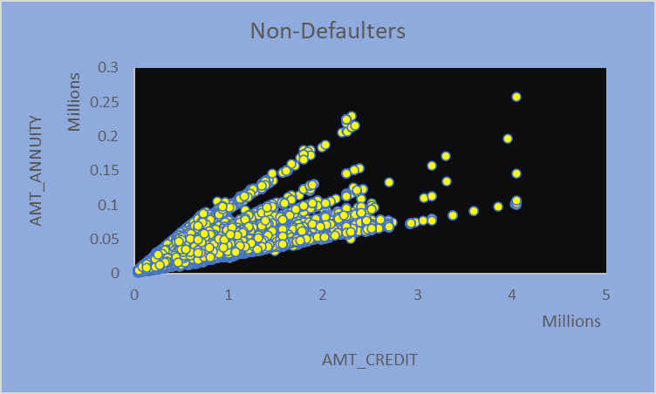
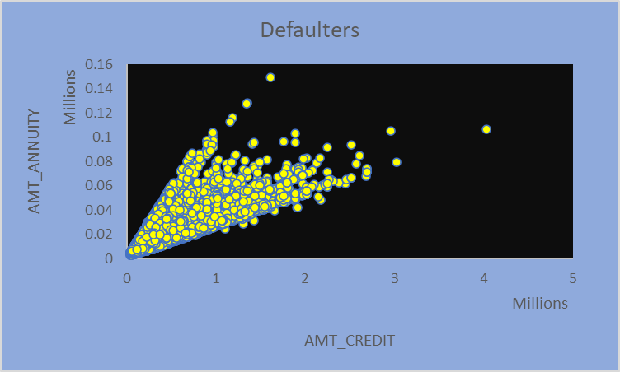
Amount Annuity and Amount Credit :The Correlation coefficient of these two variables is around 0.7 which is somewhat strong linear relationship between those variables.
If the credit amount increases amount annuity also increases in both Defaulters and Non-Defaulters case.
The Scatter plot visualizes the data efficiently.

Slide 30
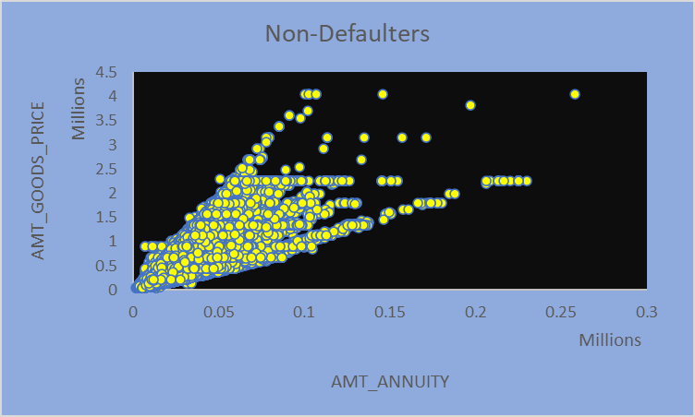

Amount Annuity and Goods Price:The Correlation coefficient between Amount Annuity and Goods price is very close to .75 which indicates the Strong linear relationship between both of them.
More the amount of annuity more will be the Amount of Goods price

Slide 31
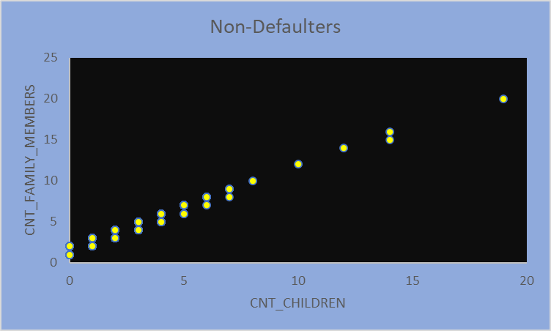
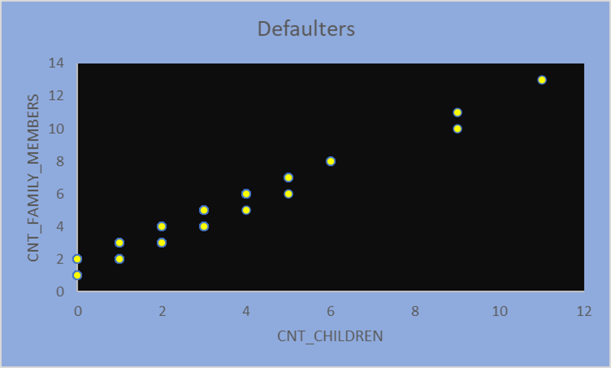
Family members and Children:The Correlation coefficient between Family members and Children is too close to 0.9 which indicates Strong relationship between these two variable.
It’s obvious that if the number of children in a family is more then the total number of family members also more.
I plotted a Scatter plot to visualize the data in effective way.

Slide 32

From this BANK LOAN CASE STUDY , I learned how the data is being analyzed in Banking sector to give loans and asses the risks in them.I gained valuble insights from this Case Study by analyzing historical loan data and customer characteristics and I may be able to develop models to predict the likelihood of loan defaults.I also knew about the “Exploratory Data Analysis” and it’s importance in data analysis.

Slide 33

--Shaik Mabu Basha

